Slide 1
Dental
Home Triage
A guide by Sulaiman Shaltoni DDS

Slide 2
Acidic pH
Maintain pH above 5.5
Drink plenty of water to provide sufficient saliva as a buffer
Don’t leave sugar on teeth for a time >30min

Slide 3
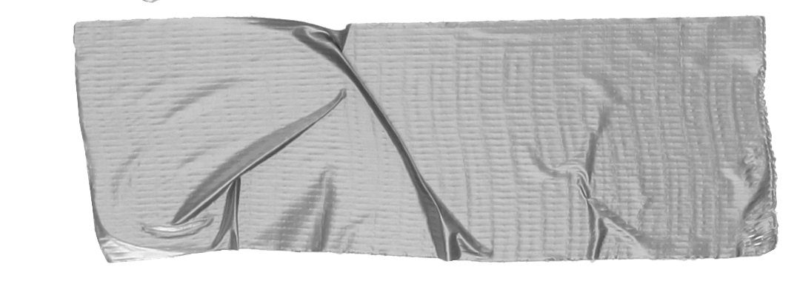
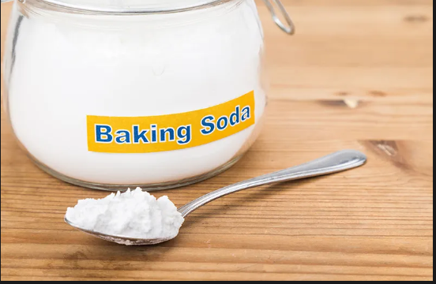
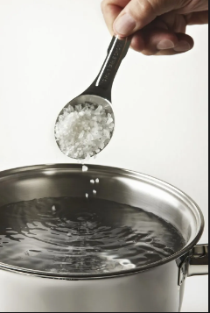
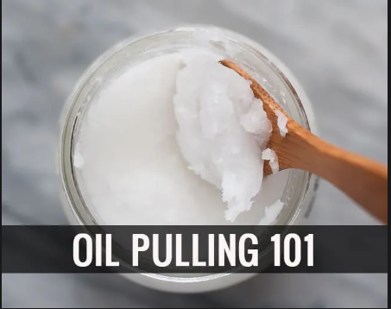
Alkalize!
Baking Soda
Oil Pulling
Salt Water
(anti-microbials)

Slide 4
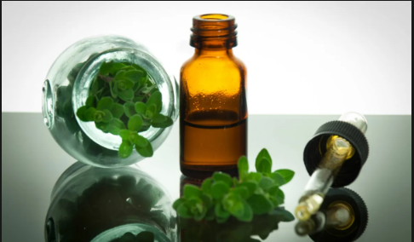
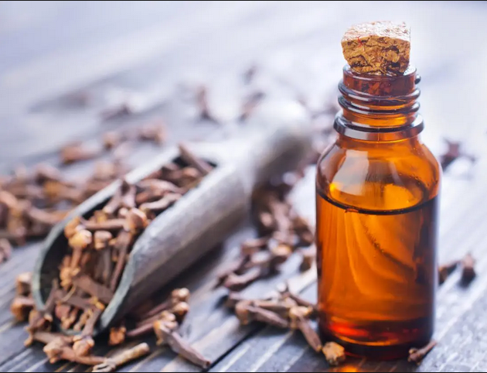
Oregano Oil
(Capsule)
Clove Oil

Slide 5
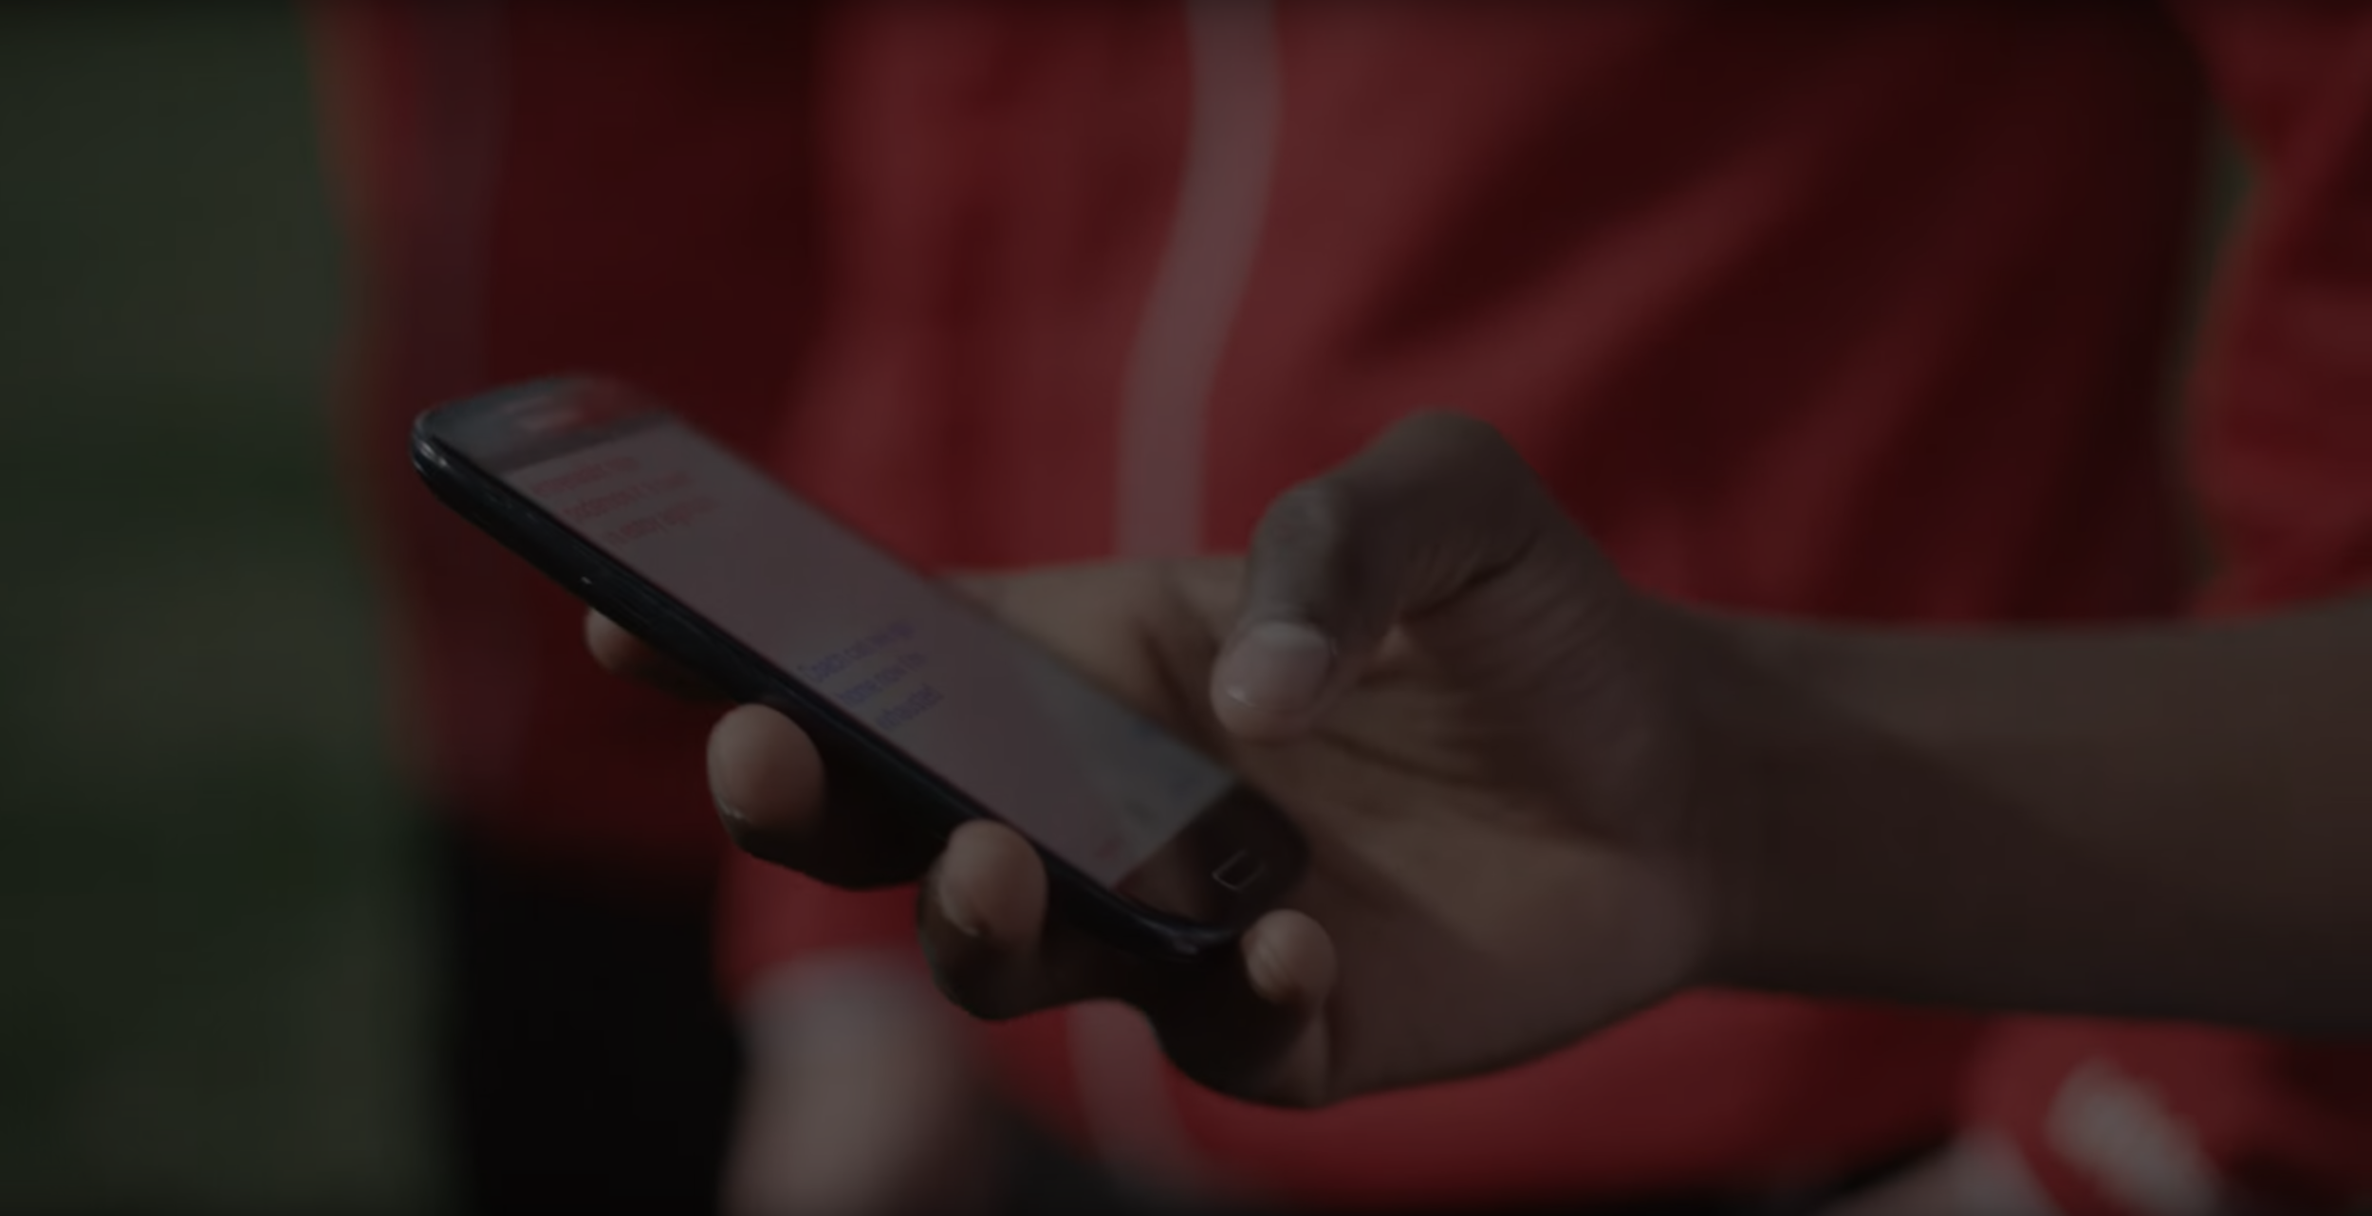
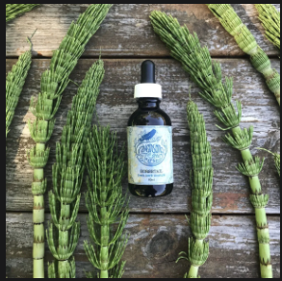
-Bone broth
-Horsetail (Equisetum Hyemale) Minerals/Vitamins/healthy foods.
(remineralization)
alternatives to fluoride

Slide 6
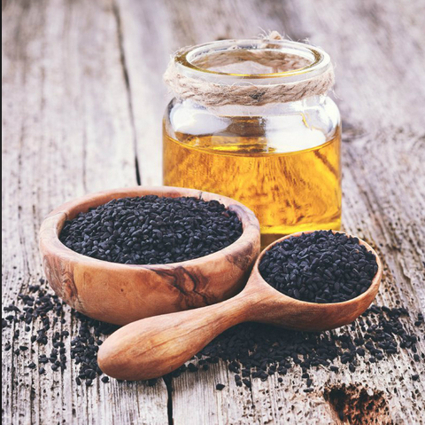
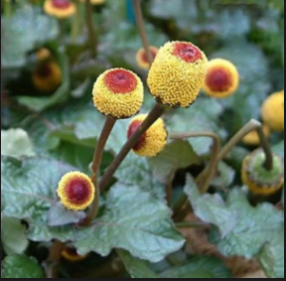
Black seed oil
Tooth-ache plant
(Spilanthes acmella medicinal)
Story for illustration purposes only

Slide 7
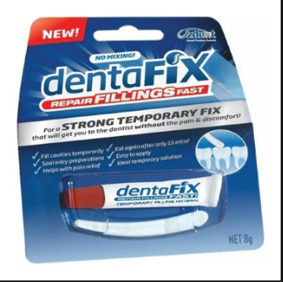
Temporary Filling Material
-Temporary
Cements
(Crowns
Bridges)

Slide 8
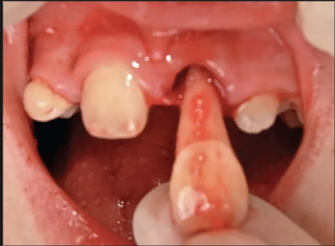
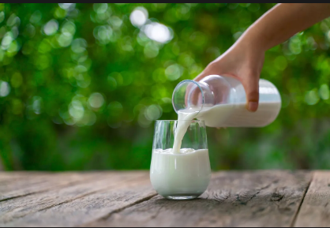
-avulsed tooth
milk, salt water soak.

Slide 9
15min Complimentary Consult
www.windingridgedentistry.com
To schedule
Questions?
info@windingridgedentistry.com
317-559-5955

